Slide 1
Lab5 5-stage Pipeline Processor

Slide 2
Notice
Lab 5 is Group work
Please follow Group ID in cloud (https://reurl.cc/nzN58n)
Lab 5 will have Group Demo
Code review
Ask some questions
Hand in format (will have penalty otherwise)
Please include ONLY Verilog source codes (*.v) and your report (*.docx or *.pdf) in the zipped
Only 1 member per group need to submit to new e3, format: “GroupID_ID1_ID2.zip” (e.g. G1_0816001_0816002.zip)
Don’t hand in testbench.v.
Don’t apply $display in any Verilog file other than testbench.v.
Deadline 2020/06/11
Notes:
Branch animation

Slide 3
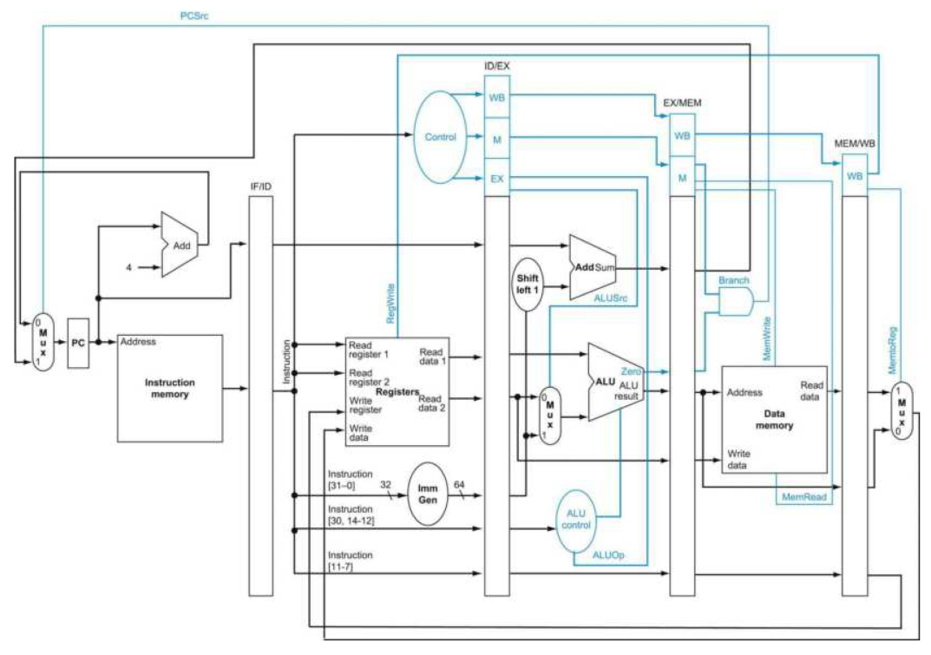
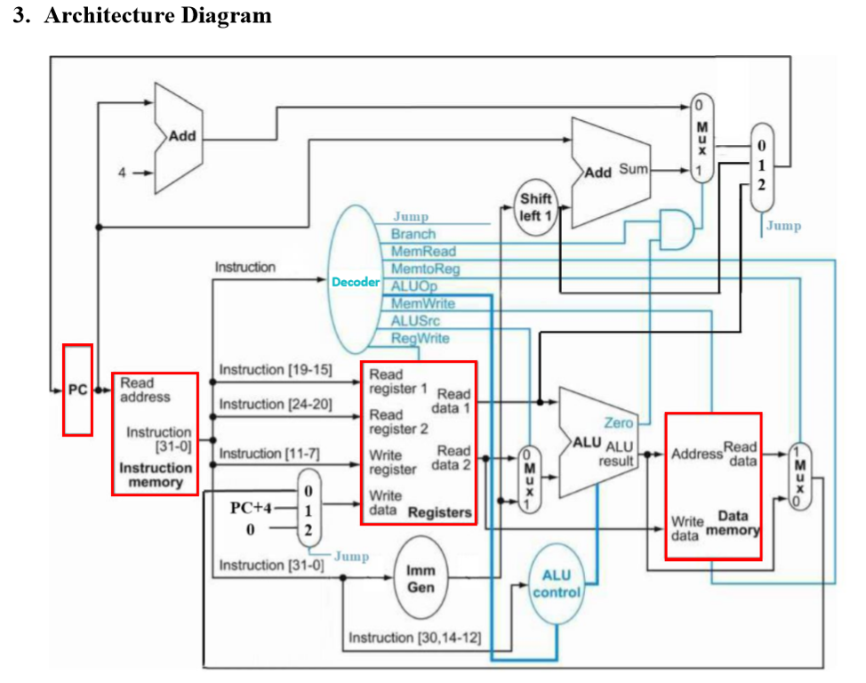
Architecture Diagram for Lab 5
Please modify your Single Cycle CPU design from Lab4 and implement a 5-stage Pipeline Processor.
Clock Positive edge triggered:
always@(posedge clk_i) begin
.
. // Code HERE
.
end
IF
ID
EX
MEM
WB

Slide 4
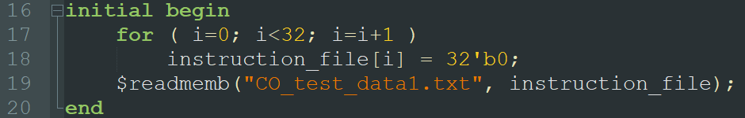
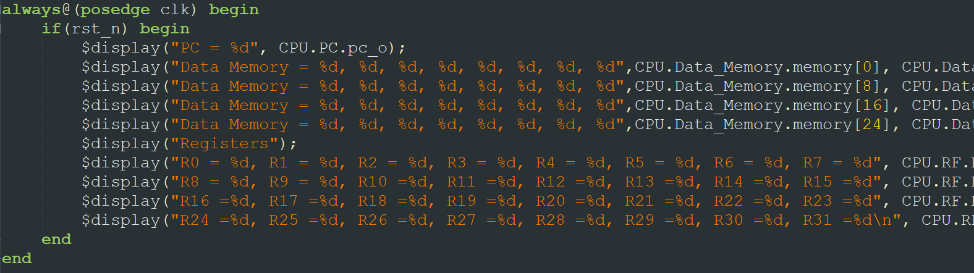
Testbench
2 test cases (CO_test_data1.txt & CO_test_data2.txt.)
Need to manual change by yourself
Edit line 19 in the file “Instr_Memory.v”
Notes:
目前作業有什麼問題？

Slide 5
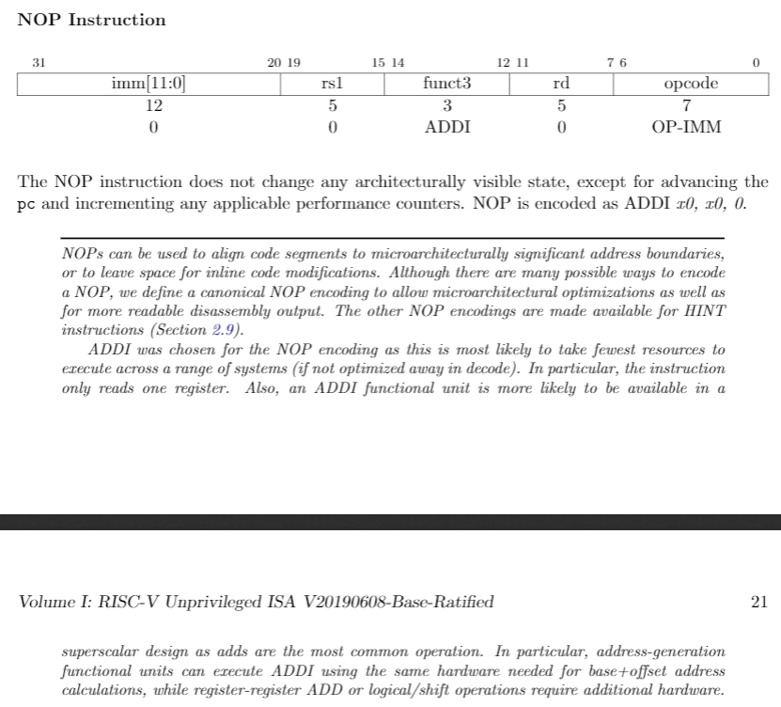
Nop instruction
Used in Stall

Slide 6
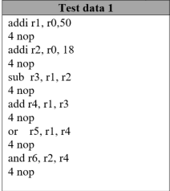
Test data 1
IF
ID
EXE
MEM
WB
IF
ID
EXE
MEM
WB

Slide 7
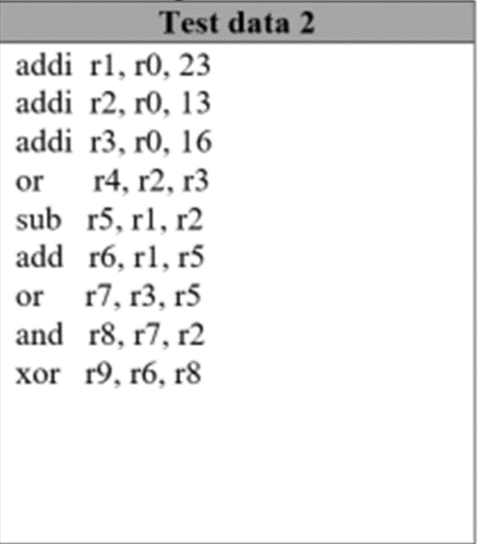

Test data 2
IF
ID
EXE
MEM
WB
IF
ID
EXE
MEM
WB
IF
ID
EXE
MEM
WB
IF
ID
EXE
MEM
WB
IF
ID
EXE
MEM
WB

Slide 8
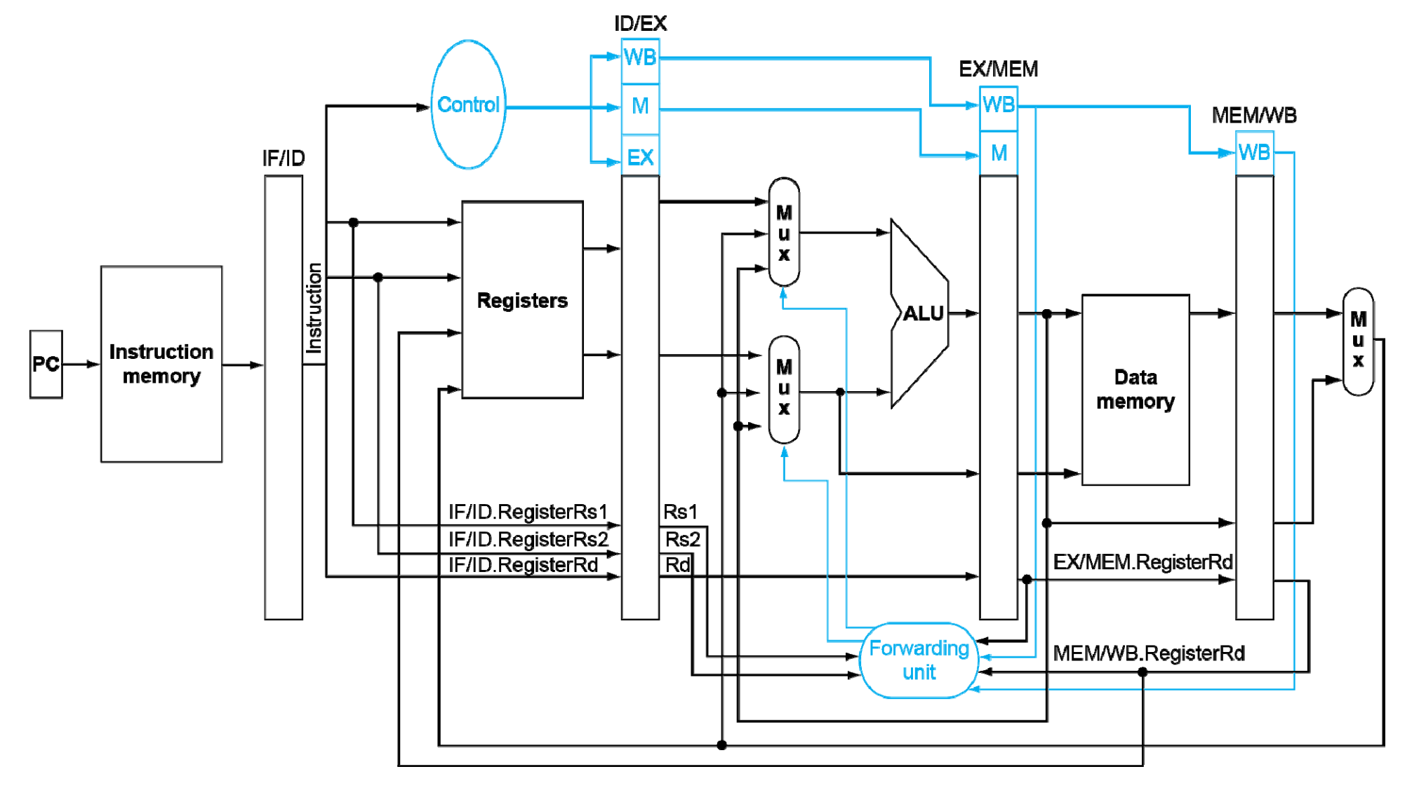
Data Dependecy
Need a ForwardingUnit.v to handle data forwarding:

